Slide 1
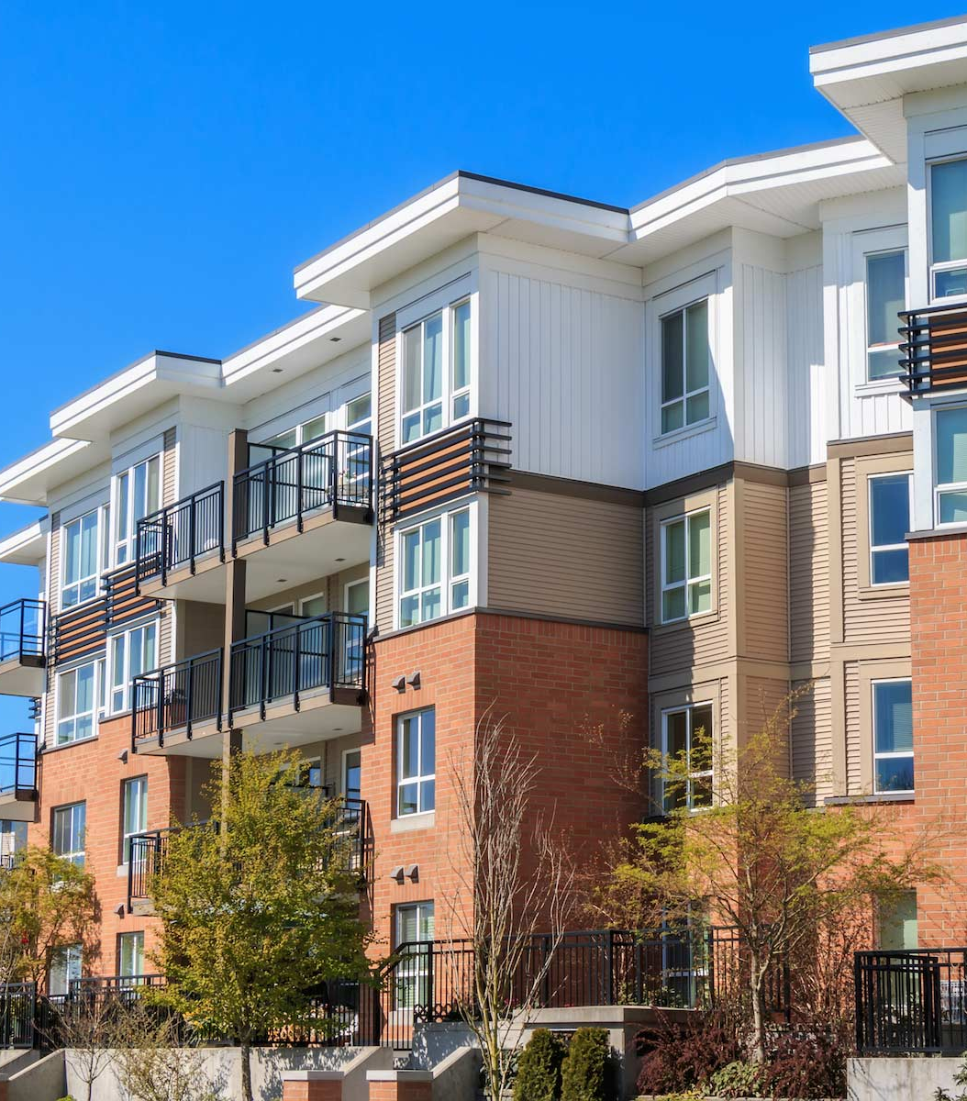

INTRODUCTION TO MULTIFAMILY FINANCING
ROD KHLEIF’s Multifamily Bootcamp
Baltimore – September 27-29, 2019

Slide 2


SINGLE FAMILY vs. MULTIFAMILY
Loan Terms
Typical terms: 15 – 30 years
Available terms 5 – 30 years
Typical terms: 5 – 12 years
Available terms 3 – 40 years
10 years
20 years
30 years
40 years

Slide 3

SINGLE FAMILY vs. MULTIFAMILY
Amortization vs. Loan Terms
Typical terms: 15 – 30 years
Amortization typically MATCHES loan term
Typical terms: 5 – 12 years
Typical amortization: 20-30 yrs NOT matching loan term
10 years
20 years
30 years
40 years
Balloon payment requires sale or refinance!

Slide 4
SINGLE FAMILY vs. MULTIFAMILY
Leverage
100 %
80 %
Up to 97% available
70-80% typical
Up to 93% available
70-80% typical
60 %
40 %
20 %

Slide 5
MULTIFAMILY – THE POWER OF STACKING NET WORTH
Multifamily Key Requirement: Net Worth must be EQUAL OR HIGHER than Loan Amount
Sample Scenario
$10 million
Net Worth Guarantor # 5
Loan: $10 M
$8 million
$6 million
Net Worth Guarantor # 4
Net Worth Guarantor # 4
Loan: $6 M
Net Worth Guarantor # 3
Net Worth Guarantor # 3
$4 million
Net Worth Guarantor # 2
Net Worth Guarantor # 2
Net Worth Guarantor # 2
Loan: $3 M
$2 million
Net Worth Guarantor # 1
Net Worth Guarantor # 1
Net Worth Guarantor # 1
Deal #1
Deal #2
Deal #3

Slide 6


SINGLE FAMILY vs. MULTIFAMILY
Typical Permanent Loan Conditions
Floating or Fixed Interest Rate
Interest Only
Prepayment Penalty
Non-Recourse
Borrower/Sponsor Qualification | Borrower’s “global” DTI (Debt-to-Income Ratio) Borrower’s Credit Score | Property’s NOI (Net Operating Income) Guarantors’ Net Worth Guarantors’ Liquidity

Slide 7
PRE-APPROVAL vs PRE-QUALIFICATION
A SPONSOR CAN BE PRE-QUALIFIED
Based on Net Worth, Liquidity, Experience
A SPONSOR CANNOT BE PRE-APPROVED FOR A MULTIFAMILY LOAN (5 units+)!
There are many elements of a deal that require a detailed underwriting AFTER the loan application.

Slide 8
A WIDE CHOICE OF MULTIFAMILY LENDERS

Slide 9

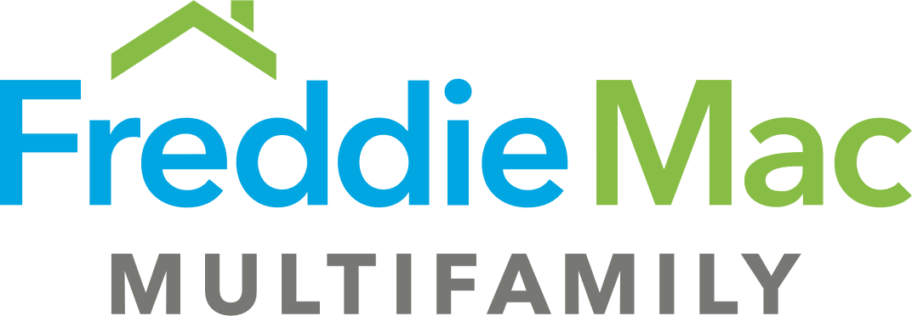

THE MOST COMMON MULTIFAMILY LENDERS
Term | 3 – 7 years, 10 years unusual | 5-10 years; hybrid options available | Usually 5-12 years, up to 30 years available
Leverage | Up to 75 % | Up to 80% | Up to 80%
Amortization | 20 – 25 years | 30 years | 30 years
Interest only | Limited | Up to 3 years, full-term available | Up to 5 years, longer available
Prepayment penalty | None to small percentage | Step-down or yield maintenance | Step-down or yield maintenance
Non-recourse | Usually recourse | YES | YES

Slide 10
THE MOST COMMON MULTIFAMILY LENDERS
Sponsor Net Worth | Flexible | >= Loan Amount | >= Loan Amount
Sponsor Liquidity post closing | Flexible | >= 9 month Principal & Interest | >= 10% of Loan Amount
Occupancy requirement | Flexible | 90%+ over previous 90 days | 90%+ over previous 90 days
Prior Multifamily ownership | Flexible | No required (Third party management required) | Typically required
Financing of rehab | Flexible | No | Yes
Property third-party managed | Flexible | Typically required | Typically required

Slide 11

HELPFUL TIPS
THIS IS A TEAM SPORT
Engage your coach, attorney, mortgage broker/lender, insurance broker, contractor, etc. early!
No multifamily experience? Partner with an experienced sponsor or pick Freddie SBL or a bank.
Understand how lenders underwrite a deal.
Ask for loan quotes PRIOR TO submitting an offer.
Line up guarantors AND sufficient funding early.
Loan proceeds, interest rate, interest only period, etc. may (and often!) change between loan application and closing.
Do not pick a mortgage broker or lender based on pricing alone. A great mortgage broker will be negotiating the murky waters of loan underwriting to ensure a successful closing.

Slide 12




HOW TO REACH US
ANTON W. MATTLI
JOHN Z. MARTINEZ
(972) 725-7878
amattli@peakmff.com
(972) 725-7666
jmartinez@peakmff.com
www.facebook.com/peakmff
www.peakmff.com

