Slide 1

Building Your Team
Copyright © 2017 Lifetime CashFlow Academy LLC

Slide 2

Property Manager
Manage several size and class of properties you’re targeting
Not a company that manages A Class properties for your C Class
CPM designation (Certified Property Manager) helpful
IREM (Institute of Real Estate Manager)
Have office well located in area
Embraced Technology (mobile web presence)

Slide 3

Commercial Real Estate Brokers
You want brokers that work RE full time
You want brokers that specialize in the size/type apartments you’re targeting
As a newbie the best brokers are often the youngest and most motivated who will work the hardest to get deals
Deep relationships

Slide 4

Real Estate Attorney
Attorney who specializes in commercial real estate
One that owns their own commercial real estate is even better
Always have contracts reviewed

Slide 5
Real Estate Litigation Attorney
To Handle Slip and Falls
Great for Questions
SEC Attorney
For Syndicating Deals

Slide 6

Commercial Lenders
Commercial bankers and brokers
For small apartments and complexes local and regional banks
For loans over 1mm good FNMA/Freddie Broker

Slide 7
Accountant
Understands Cost Segregation
Help with Projections
Insurance Broker
Can write Insurance anywhere in the US
Property Inspector
Get Referrals from Property Manager or Broker

Slide 8
Advantages of Creating a Partnership for your Multifamily Investing
You can divide up the responsibilities
Combine an analytical person with an outgoing personality
Help you reach out to investors for equity
Help you obtain financing. Strength in numbers

Slide 9
Partner Considerations
A partnership is a like a marriage. You can’t fire them.
Trust your intuition.
You want complimentary skill sets. You do NOT want to be alike!
Try to explore their past work ethic.
Have the difficult conversations up front!
1. What happens if things don’t work out.
2. Exit plan for death or dissolution. (buy sell)
3. Who is responsible for what duties?
4. How is decision making handled?
5. Salaries if any?

Slide 10
Partners and Investors: Joint Ventures vs. Syndication
Joint Venture
Members take part in management, sign on debt etc.
Syndication
Members do not take part in management.
It becomes a security and subject to SEC

Slide 11
Equity Investors (Equity = Down payment/up front monies for closing costs, cap X)
Get a piece of the equity in the deal
Get their proportionate share of cash flow and profits from sale
The split between you and your Equity Partners is determined by the numbers of the deal
Typically stay in the deal if you refinance
(Recommend higher minimum investments. IE: 50k plus)

Slide 12

Funding Sources for Equity
Friends and Family
Credit Cards
Equity LOC
Roth Self-Directed IRA’s
Private Money from Investors
Hard Money
Crowd Funding
Family Offices

Slide 13

Debt Investor
They do not receive equity
They are like a bank
More difficult to raise debt than equity. (people like upside)
Can refinance them out of the deal
(Paid in full upon refinance or sale)

Slide 14

How to Find Investors /Partners
Everywhere people gather and meet
Church
Sporting Events
Health Club
Meetup Groups (create your own)
REIA Meetings
Networking Events
Do Real Estate Investing Presentations to groups
(BECOME A GREAT ASKER OF QUESTIONS)

Slide 15

Elevator Pitch (What Do You Do?)
I’m investing in Multifamily Properties in growing markets for cash flow and appreciation. I’d love your help. Who do you know that might be interested in investing with me?
We help people like you invest in Multifamily Properties
We put together groups of investors to invest in Multifamily Properties

Slide 16
When Getting to Know
Find out their investment goals
Long term cash flow vs. 5-7 year horizon for highest return
When do they need capital back?
Pay attention to personality. Will you like working with them?
If interested have them fill out questionnaire

Slide 17

Private Money from Investors
Remember managing your investors is usually harder than managing the asset. (property)
If they nitpick about your acquisition or other fees get rid of them. “If you’re more worried about what I’m making than what you are then this probably isn’t a good fit.”

Slide 18
Nurturing Relationships with Investors
Phone calls
Emails
Newsletters
Articles touting the area you’re targeting
Group Meetings
Powerpoint Presentations
Gifts
Must keep your investors warm with monthly contact

Slide 19

Brand Yourself
Pick a Company Name
(Holdings, Group, Equity, Capital, Properties, Partners)
Logo
Create Website
Business Cards

Slide 20
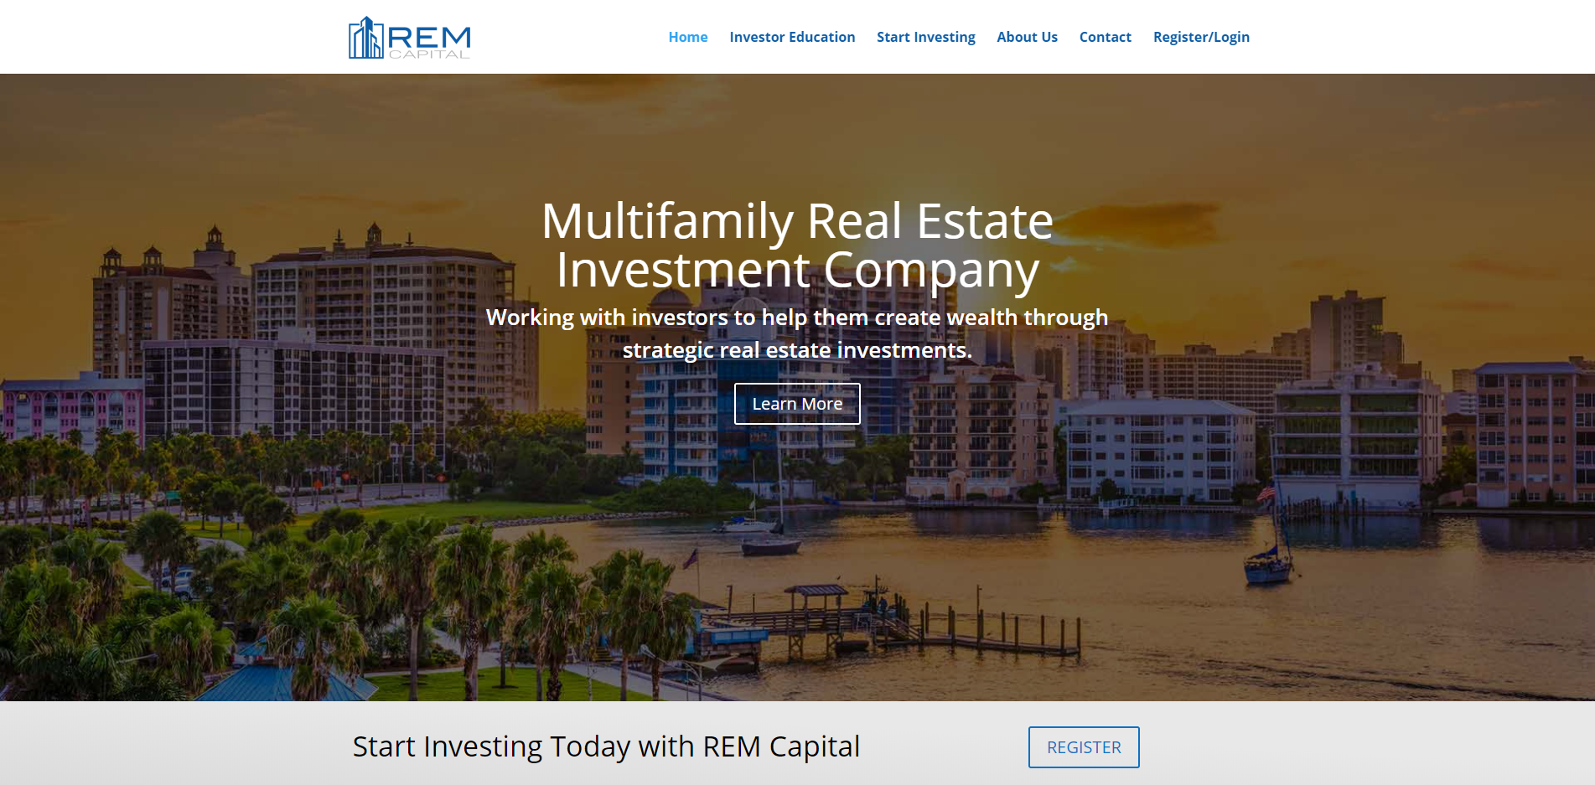

Slide 21
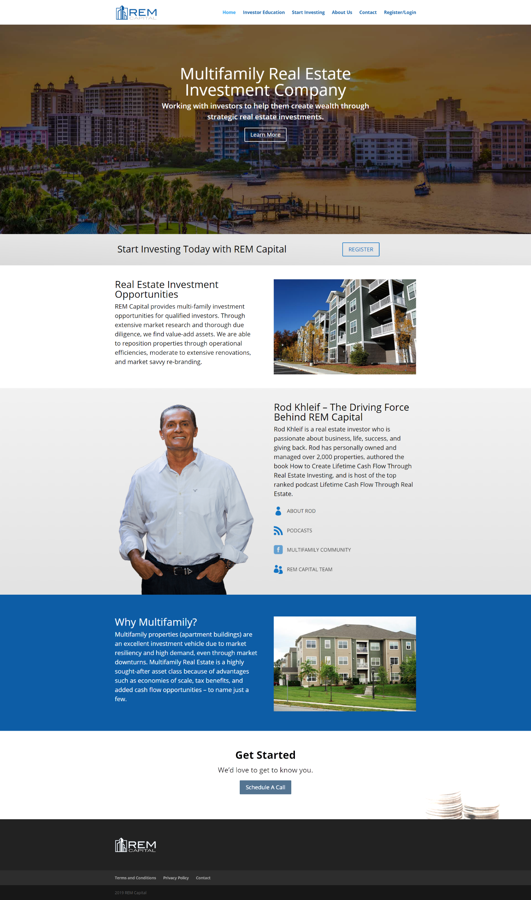

Slide 22
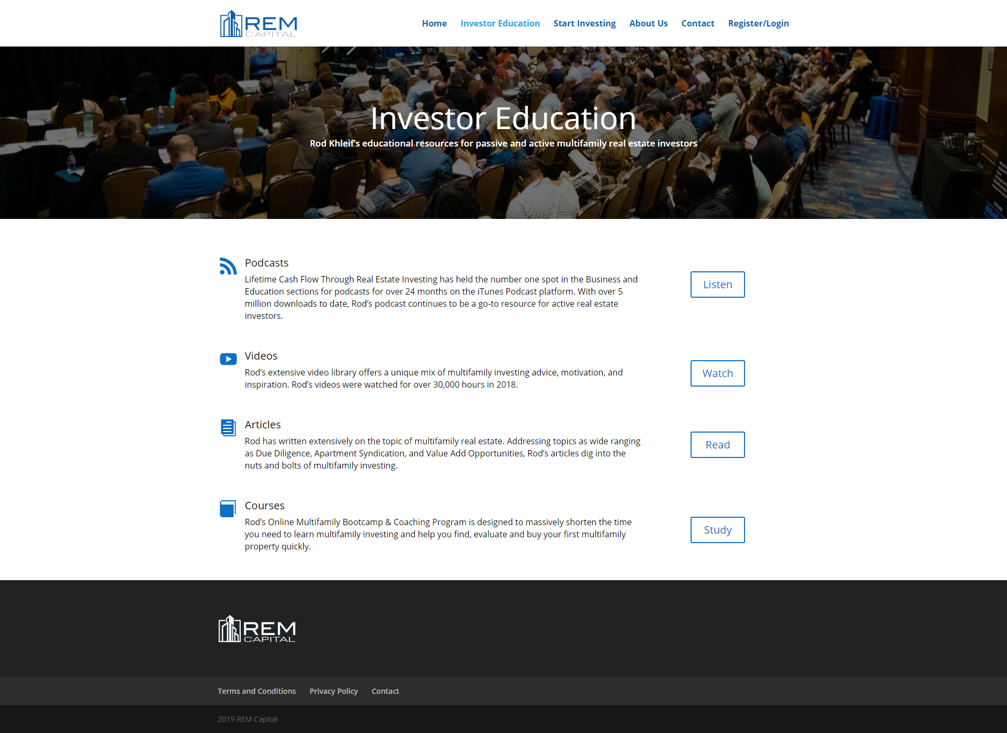

Slide 23
