Slide 1

Key Financial Formulas

Slide 2
Loan to Value
Loan to Value (LTV)
Mortgage amount / property value =LTV
Simply is just the ratio of how much banks will lend based on value
You can expect to see banks loan anywhere from 70%-80% on average

Slide 3
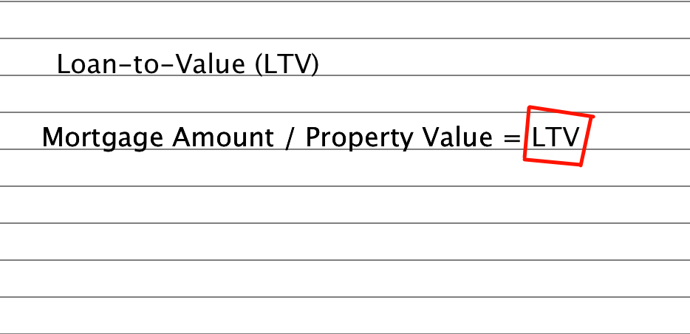


Slide 4

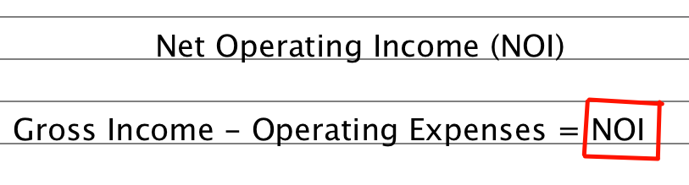
Net Operating Income - NOI
The most important
(Does not include debt service)

Slide 5
Capitalization Rate- (Cap Rate)
The Capitalization rate is the rate at which the NOI repays the purchase price on an annual basis.
The formula for calculating the capitalization rate can be expressed the following way:
Capitalization rate = Net operating income / current market value
If you have two of the variables you can solve for the other one

Slide 6
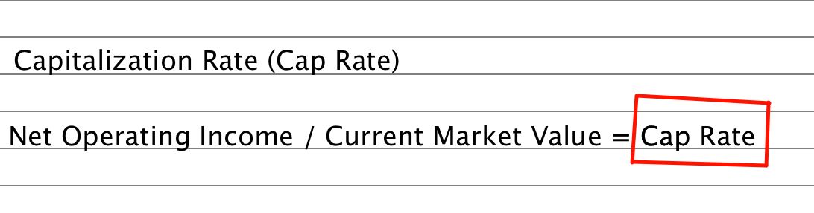

Slide 7

Cap Rates are Affected by:
Location of the property
Overall market condition
Supply and demand
Investment risk
Property appreciation
Level of property management
Tax benefits associated with the property

Slide 8
Cap Rates
Class A & B properties have very low Cap Rates due to stability
Low Cap rate means Large investment for small income stream
D properties have high Cap Rates because they’re risky. The higher the Cap Rate the cheaper the property
Large Cap Rate means smaller investment for larger income stream
Cap Rates don’t take financing into consideration
Based upon paying in cash

Slide 9

Average Cap Rates
Class A: 3%-6%
Class B: 4%-7%
Class C: 6%-10%
Class D: 10% and up
I like cap rates of 8% or better

Slide 10
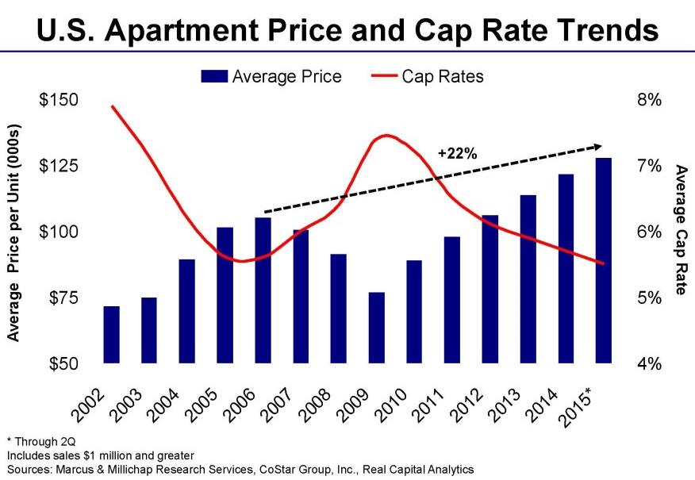

Slide 11
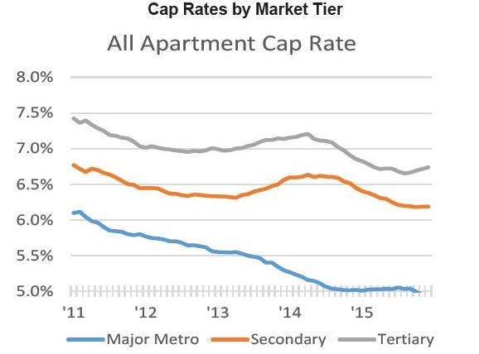

Slide 12

Determining the Market Cap Rate for a Property:
Check recent sales on LoopNet
Other investors
Property managers
Lenders
Brokers
Appraisers

Slide 13

Compare these two properties:
Class D – 30 Unit Multifamily
Average Rent: $675 per unit
Gross Income: $243,000
NOI: $121,500
Cap Rate: 10%
What is the value?
Or:
Class B – 15 Unit Multifamily
Average Rent: $1,100 per unit
Gross Income: $198,000
NOI: $99,000
Cap Rate: 8.25%
What is the value?

Slide 14
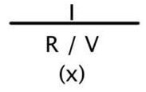


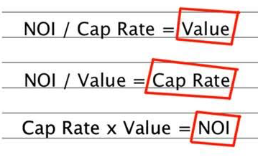

Slide 15

Operating Expense Ratio
Operating Expense Ratio (OER)
Operating expenses / gross income = OER
You add up all of the properties expenses and divide it into the gross income
Rule of thumb around 50%

Slide 16
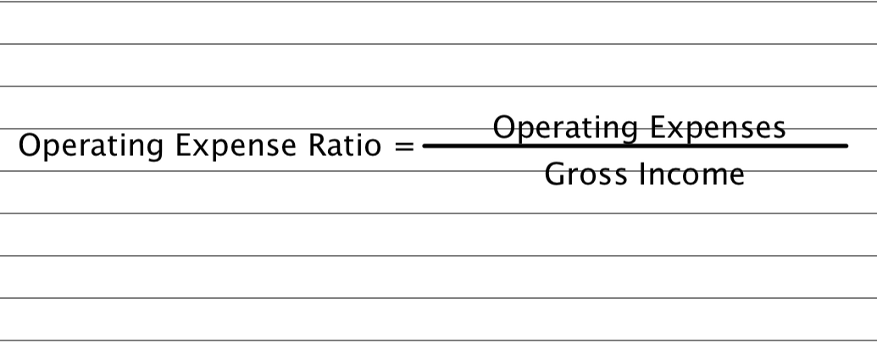

Slide 17

Cash on Cash Return
Cash on Cash Return (COC)
NOI – Annual Debt Service / Acquisition Cost
COC gives a much more accurate figure on return
Includes Debt
I like a COC of 12% or better

Slide 18

Cash-on-Cash Return
Ex:
Purchase Price = $1,000,000
Down Payment = 25% $250,000
Bank Loan = 75% $750,000
No repairs needed
Cash Flow after debt = $50,000
Cash Flow of $50,000 / cash investment of $250,000 = 20% cash-on-cash return

Slide 19

Internal Rate of Return (IRR)
IRR includes all returns to the investor over term of the investment. (Total Return)
IRR is also called Cash on Investment
IRR includes the benefits of three things:
1. Appreciation
2. Cash Flow
3. Principle reduction on debt
Manual Page 88

Slide 20
Debt Service Coverage Ratio
Debt Service Coverage Ratio (DSCR)
NOI –/ debt service payment = DSCR
Used by lenders
Bank wants to see a percentage of the NOI left over after the mortgage is paid
Anything less than 1.25% debt coverage and they probably won’t approve the loan
Most banks want at least 1.25 to approve
A DSCR of less than 1 means there’s negative cash flow
For example, a DSCR of .85 means the NOI can only cover 85% of the mortgage payments

Slide 21
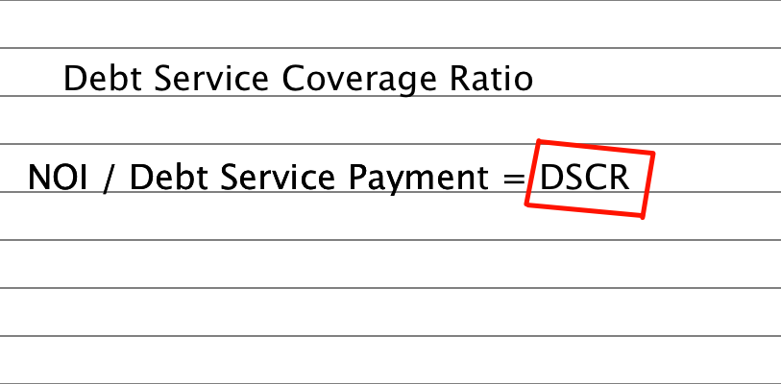

Slide 22
Rod’s Target Minimums
DSCR
We like at least 1.6 or higher.
1
Cap rate of 8% or higher
2
Cash on Cash Return 10% or Higher
3
Manual Page 89

