Slide 1
LOI
The letter of intent is used to show your intent/desire to purchase a commercial property
All the LOI does is start the conversation with the seller, It begins the process and negotiation
It can be used prior to submitting a contract
Will sometimes save unnecessary legal fees
Short document, 2-4 pages
Non-binding
Purchase and sales contract contains all legal details and language
LOI only contains the most important deal points

Slide 2
LOI Will Contain
Name of property, if it has one
Property address
Property tax identification number
Legal description of the property
Purchase price
Earnest money deposit amount
Payment arrangements such as cash, mortgage, seller financing, etc.
Projected closing date
Terms and time frames for your due diligence
Who will create the contract

Slide 3
LOI
In addition, you want to include any non-standard or large requests
Examples would be:
Seller financing
Seller paying closing costs
It might also include language stating the owner will not seek other offers for a period of time

Slide 4
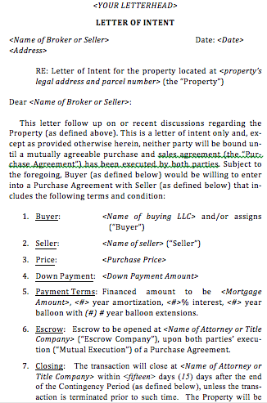
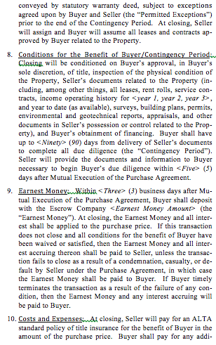

Slide 5
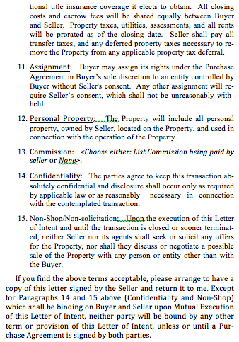
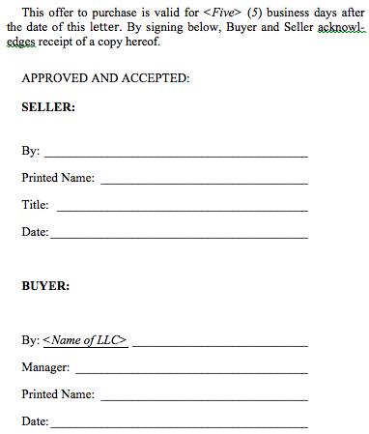

Slide 6
The Offer/Purchase Contract
Always use an attorney to write the contract or to review the broker’s contract.
When dealing with partners, always use an escrow agent for all the partnership money
The contract should always have an effective date in addition to the date it was signed

Slide 7

Due Diligence

Slide 8

Due Diligence
Comprehensive Due Diligence Checklist is a Must
(Free Multifamily Toolbook checklist download at RodKhleif.com)
Important Mindset Shift you Must Make
No stone left unturned
No phone call left unmade
No county office visit left unmade

Slide 9

Due Diligence
Call the Chamber of Commerce and/or Economic Development Office
How is business in the area?
Any incentives for investing?
Have businesses been coming or leaving?
Any new major employers you know of?

Slide 10
Due Diligence
We talked about analyzing the neighborhood, and now that you’re under contract you will actually physically visit the property and the area
Get in the car and drive the neighborhood
Ask yourself,
Would I want to live here?
Are there any jobs around here?
Would I want to work in this area?
Is public transportation nearby and accessible?

Slide 11

Due Diligence
Where is the closest grocery store?
Are schools nearby?
What is their rating?
Are there things to do?
Examples could be beach, hiking, recreation
Or shopping, stores, businesses, movie theater, etc.

Slide 12

Due Diligence
What about safety?
Would you feel safe collecting rents?
Go past 10pm, do you feel safe?
Go on the weekend
Utilize Spotcrime.com
Call the non-emergency police number
Ask if the property you’re interested in has had problems with crime in the past
People want Clean-Safe-Affordable
-Security? Clear Line of Sight? Lighting?

Slide 13

Due Diligence
Speak to City Planning and Zoning
Any violations on subject property in past 5 years?
Any permits been pulled?
Any zoning changes coming that might impact the property?
Any infrastructure coming that might impact property?

Slide 14
Due Diligence
Speak with contractors who have worked on the property
Plumbers, electricians, HVAC, maintenance, etc.
What are typical problems?
What do they think of the infrastructure?
Do they think anything needs to be repaired or replaced immediately?
Any deferred maintenance?
Also have new contractors come out
Tenured ones often may mitigate the scope or quality of their past work

Slide 15
Hazards to be aware of:
Mold: Must determine what caused it. IE: A/C lines leaking, roof leaks, negative drainage:
If you can find where the water is coming in then okay to buy. You can’t, don’t buy it.
Lead Based Paint: (pre 1978 built properties)
Every unit should have a tenant-signed compliance letter
Ideally remove and replace if you can. If you scrape you must vacuum up scrapes.
Asbestos: Don’t buy this property unless the seller removes it. (You always do environmental studies even if seller financed!)
Manual Page 127

Slide 16

Due Diligence
Speak to tenants
Do they like living there?
Is it quiet and safe?
How are things maintained?
What changes would you like to see?
Will they stay or move when lease expires?
Manual Page 128

Slide 17
The Inspection Process

Slide 18

The Physical Inspection Process
Use a Building Inspector!
Roofs
HVAC, plumbing, electrical
Foundations
You also want to physically walk the unit
Inspect each unit
When walking the units, take pictures
Better to have someone video

Slide 19

The Financial Inspection Process
Matching up bank statements to income statements
Matching up deposits to bank statement
Perform a lease audit
Ensure that info from rent roll matches up to signed leases
Log all lease dates and amounts

Slide 20

The Statement Inspection Process
Verify utility bills against income statements
Water
Electric
Sewer
Trash
Etc.

Slide 21


The Contract Inspection Process
Read over all contracts
Landscaping
Pool service
Snow removal
Etc.
Take special note to the laundry contract
Manual Page 130

Slide 22
Do not be Afraid to Back out or Re-trade if Warranted
If there were material things left out or miss-represented then okay to re-trade
Do not abuse this process or you will lose broker relationship and damage reputation
Do not be afraid to walk away!
Sometimes the best deals are the ones we do not buy!

