Slide 1


MASTERING CONSISTENT DEAL FLOW

Slide 2

“Be A Problem Solver and Entrepreneur, Not Just an Investor” -Rod Khleif

Slide 3

The Importance of Building Relationships
Real estate is a relationship driven business
It’s impossible to do it alone and unnecessary
This is a team sport

Slide 4
You Need Relationships With:
Sellers
Investors
Bankers & Lenders
Brokers
Service Providers
Insurance Agents
Property Management Companies or your Onsite Staff

Slide 5
Foundation of a Successful Business Relationship
Rapport
Commonality
Trust
Respect
Overall “I like this person”
People only do business with those they like

Slide 6

Utilizing Brokers
One good broker can make you wealthy
Focus only on multifamily brokers
Ask the good ones to refer you to other team members

Slide 7

Finding Brokers - LoopNet
Multifamily for sale
Find a broker who has several properties for sale
You’re calling “in regards to one of their LoopNet listings”
Broker Script

Slide 8

Script
Hello, my name is _____, and I’m an investor out of “your city”, how are you today?
I’m calling in regards to one of your LoopNet listings. It’s “Shady Oaks”…Is that property still available?
Great, I definitely want to see some more information on that. Before you send that, I do have a few quick questions.
What’s the story on this property? Why’s it for sale?
Interesting, this sounds like it has potential. Here is my contact info:
Also, do you typically list properties similar to this one? My partners and my criteria is “_____”, and we’re currently looking to acquire several properties within the next year. Feel free to send anything similar, I’ll be sure to get back to you as soon as possible.

Slide 9

Valuing Brokers – Following Up
Most people never follow up
Say why the deal didn't work for you with specifics from your analysis
Refresh their memory on your exact investment criteria
Respect the broker’s time
Set yourself apart

Slide 10

Brokers – Consistent Communication
Every few weeks email or call your broker(s)
Maintaining the relationship is key
How do you set yourself apart?
Goal is to get off market deals

Slide 11

Online Sites
“LoopNet is the place deals go to die”
(not true)
Look for what others have missed
Could you increase income or decrease expenses?
What expenses are high?
Management overpriced?
Are the rents at the current market rate?
What’s the area’s vacancy percentage?

Slide 12
Example: 24 unit near Tampa, FL
Listed on LoopNet for almost 3 years
Was being sold at a 6 Cap
Didn’t have any info or even rent amounts listed
Very little info because sellers were in their 90’s
Determined rents were $150 below market
Expenses were very high
Being overcharged on landscaping and maintenance
Huge value opportunity overlooked by thousands

Slide 13

Other Online Sites
Other listing sites include
City Feet (cityfeet.com)
NAI Global (naiglobal.com)
The Commercial Investment Multiple Listing Service (cimls.com)
Broker sites that have a high volume of properties
Marcus & Millichap (marcusmillichap.com)
CBRE (cbre.us)
Cushman and Wakefield (cushmanwakefield.com)
Coldwell Banker Commercial (cbcworldwide.com)

Slide 14

Be on the Lookout for:
Abnormally low rents
Abnormally high or low expense ratio
Expenses missing
Seller that has become increasingly motivated due to “stale” listing
Very little information available
The market’s vacancy percentage compared to subject property’s %
Overpriced management

Slide 15
Property Management Companies
Property management companies speak with their multifamily owners at least once a month
They also know the property better than anyone, including the owner
The problem tenants
The most common maintenance problems
The best contractors
When the owner wants to sell
Know the “situation” of every owner and property
They know who wants to sell now
They know who wants to sell soon (6 months – 2 years)
They know who will always sell if the price is right

Slide 16

Auctions
Always listed significantly below market value
Usually below replacement value
This is by design to entice you to bid
Few things to be aware of:
Properties sold as is
Sellers can hide defects
No contingencies
Need financing lined up prior
Must have money ready prior
Online and Onsite auctions and sometimes webcast

Slide 17
Auction Houses
Biggest nationwide auction houses
Auction.com / Ten-X (ten-x.com)
Tranzon (tranzon.com)
Treasury.gov/auctions
Williams and Williams (williamsauction.com)
Hudson and Marshall (hudsonandmarshall.com)
Albert Burney (albertburney.com)
Bill Fair & Company (billfair.com)
J.P. King (jpking.com)
Joe Roebuck (roebuckauctions.com)

Slide 18
Two Categories of Auctions
Reserve auctions
Minimum bid amount must be met
Absolute auctions
Property will sell for whatever highest bid is
Does highest bidder always win?
Yes, in absolute auctions
In reserve auctions the seller can refuse to sell if the bidding doesn't reach their minimum price

Slide 19


Slide 20
“A Secret to Success in This or any Business is Being Willing to do What Other People Won’t”

Slide 21

Driving for Dollars: What to look for
No cars or cars that have been parked a long time
Boarded up windows
Dirty and signs of vacancy
Poor landscaping

Slide 22

Cold Calling
Better after sending letters
Script in document library
Do what other people are not willing to do
Hire stay-at-home to set appointments

Slide 23


"Before we met Rod we did not have any multifamily property. We now have over 350 units!"
Jacob Blackett
Jacob Blackett
Sterling White

Slide 24

Other Ways to Find Deals
Classified of Newspaper
Mom and Pop Owners
Smaller Deals
We found a 19 unit that only 2 people called

Slide 25
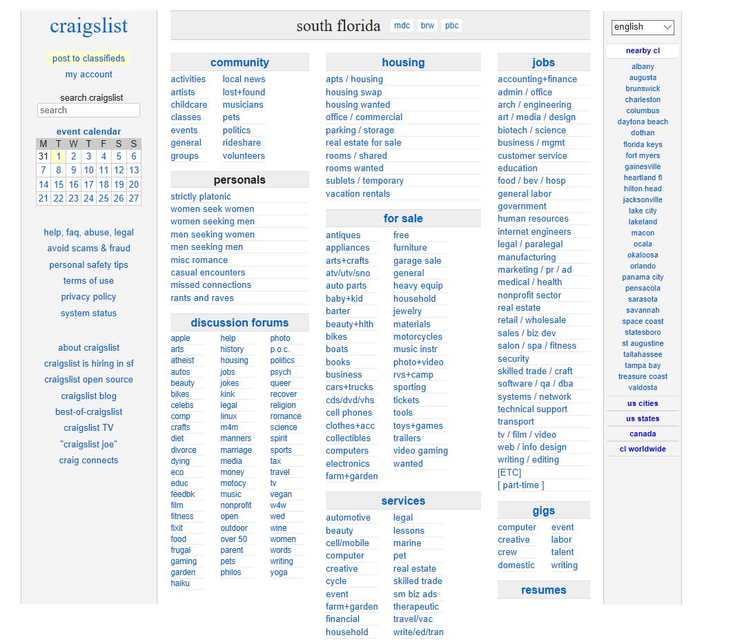
Craigslist

Slide 26
Craigslist is a Great Deal Source
The ability to find hundreds of leads in just a few hours
Only takes 10-15 minutes a day
High quantity of mom and pops on the site
Free!
Literally works in basically every market
Nobody looks for deals there anymore (except you)

Slide 27
3 Methods to Maximize Success on Craigslist
Reach out to properties in the for sale section
Post ads saying you buy multifamily properties
Cold call “for rents”

Slide 28

Reach out to Properties in the For Sale Section
Craigslist Email Script
Hi, my name is _____. I’m sending this message in regards to your duplex for sale at ___________________.
I’m a local real estate investor, and buy properties very similar to yours in the area. I’m highly interested and would love to get some more information from you regarding the property. I would love to talk soon.
My contact info is:

Slide 29

Post Ads Saying you Buy Multifamily Properties
Focus on pain points:
“Sick of dealing with problem tenants?”
“Tired of late rent and evictions?”
“Is your income property not producing any income?”

Slide 30


Brian A I got my first deal off Craigslist! A 36 unit for around $1M. It works
There are strategies that work very well with Craigslist

Slide 31
MLS/Agents
A solid and reliable residential agent is a great resource
Set guidelines
First, you’ll want to have them set up an alert for each multifamily property that hits the MLS.
You’ll next want them sending you anything that fits your criteria.
Make an offer:
On all properties that fit your requirements for size, price range, number of units, etc.
On any foreclosures, HUD properties, bank-owned, and short-sales
On any multifamily properties that are labeled “as-is, vacant, and price reduction”

Slide 32

Properties WITH CODE VIOLATIONS Often Fly Under the Radar
These leads are often some of the most motivated sellers you can find
This strategy goes hand in hand with driving for dollars, as many properties with overgrown grass, are vacant, poorly taken care of etc. will have code violations as well

Slide 33

Target Owners Going Through Evictions
You ideally need to go to the courthouse to get a feel for the local eviction climate
Some information will be online, but most effective to have face time with the owners immediately after the case is finished
Typically, evictions take place on the same day each week or month
Attend the cases and start a conversation with the owner.

Slide 34

Networking with Probate Attorneys
Great way to get off-market deals
The best way to get the ball rolling with them is to call and ask if you can come in and have 10 minutes of their time

Slide 35

Buying from Banks
Banks don’t want properties on their books
They are not in the real estate management business
Set up relationships with local bankers
You’re a problem solver!
Become their go-to guy

Slide 36



Other Ways to Find Deals
Service Companies who work in industry
Pool guy, window repair, landscaper
Ask these guys if they know anyone who might be selling soon
Sellers will say “I’m going to sell soon, we’ve got to make the place look better”
Offer a finders fee

