Slide 1

General partner splits

Slide 2
  Elephant in the room
    How do you hire people to raise money for your deal?
      Can’t
      Assumes a syndication (key)
      Otherwise everyone brings a roughly proportionate share of equity

Slide 3
  Elephant in the room
    Signing on the debt is active but just the beginning
    Could put someone on the payroll if you didn’t want to make them a partner and their job could be to find and develop investors
    Could pay a finder fee on a per person basis for introductions (but can’t be tied to investment success) similar to buying an accredited investor list

Slide 4
General partner split
Components of deal assuming a syndication
  Pre-close work (due diligence, sourcing/underwriting, transaction manage
  Pre-close money (escrow, deposits, etc)
  Balance sheet/liquidity/experience
  Asset management (investor relations, site visits, managing property manager, business plan execution, etc.

Slide 5
General partner split
Components of deal assuming a syndication
  Pre-close work 15%
  Pre-close money 15%
  Balance sheet/liquidity/experience 15%
  Asset management 55%

Slide 6
  Also remember the components
      Equity (promote)
      Asset management fee
      Acquisition fee
      Other fees?

Slide 7
  Two different models
    All split equally (less flexible, builds long term brand)
    All split uniquely (more flexible, less long term brand)

Slide 8
Debt market update

Slide 9
Debt market update
  Third quarter is typically slow
    Why?
  Spread between CAP rate and interest rate
  Rates are down, what does that mean?

Slide 10
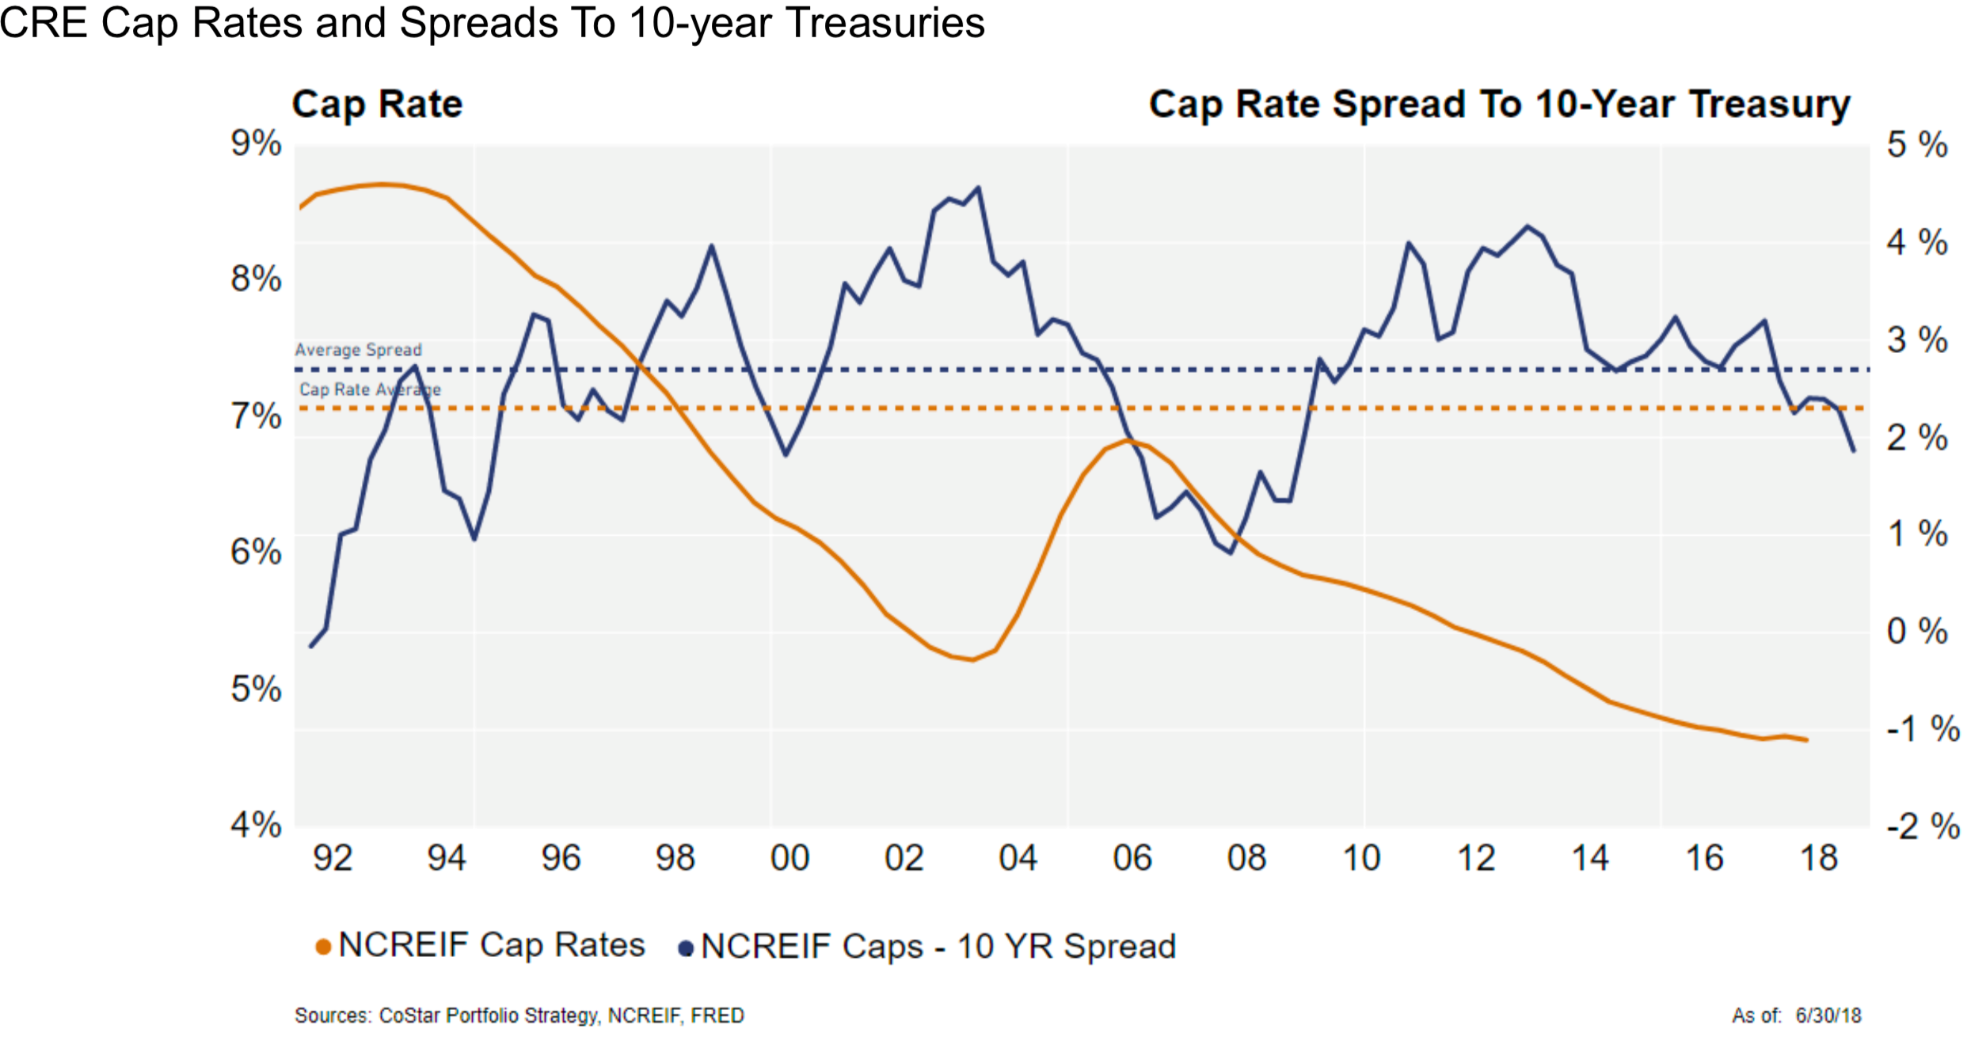
Debt market update

Slide 11
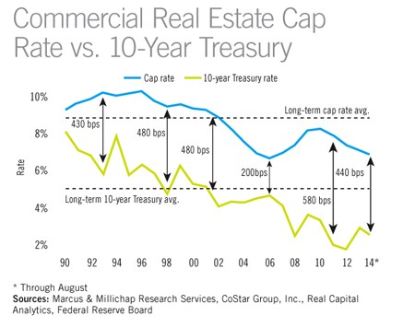
Debt market update

Slide 12
Fannie Mae – Green Rewards
    Stabilized property in top or standard market
    Supplemental loan (cash out or relever)

Slide 13
CMBS (commercial mortgage backed securities)
    Haven’t been very competitive in multifamily because of agencies
    Previously focused on office and retail
    One time loan
    I/O 1 year up to 10 years (depends on market and experience)
    Typically a 10 year product with fixed rate
    Pricing is fairly comparable to agency – 4-4.5% at the moment
    Prepayment is defeasance (more than yield maintenance)
    Loan servicer is third party
    Stabilized but mostly based on debt yield (NOI / loan amount)
    Limited rehab
    Sometimes second mortgage mezz loan available

Slide 14
Bridge Loan
    Will give you the highest loan amount and also highest cost
    Floating rate with LIBOR (5-6%)
    Full term interest only but term is 3 years +1 +1 (full amort)
    Also use debt yield test and LTV tests
    Will hold CAPEX and release with payment
    Prepayment flexibility (only 6-12 month lockout)

Slide 15
Private Lender
    Addressing gaps between agency and CMBS
    Potentially more i/o period
    Fix rate for 10 years
    No supplemental loan
    Essentially same as agency but without supplemental

Slide 16
Debt market update
Questions?

